Slide 1


NON TRADITIONAL
PROJECT MANAGEMENT
Christine Olukere
YWCC 307

Slide 2




What is project management?
Project management is the use of specific knowledge, skills, tools and techniques to deliver something of value to people. The development of software for an improved business process, the construction of a building, the relief effort after a natural disaster, the expansion of sales into a new geographic market—these are all examples of projects (PMI).

Slide 3

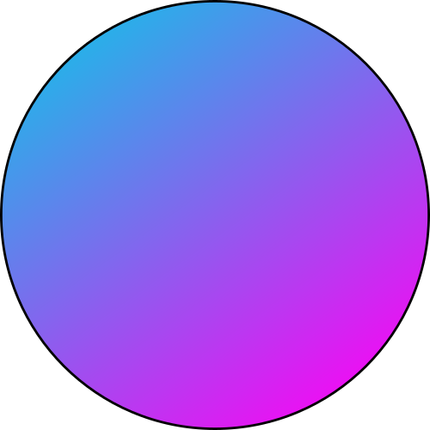
The Problem
11.4 %
29%
Amount of business investment wasted due to poor project performance (according to PMI).
Amount of project professionals that cited an inadequate vision or goal for their project as a primary cause of failure (PMI).

Slide 4

Solutions
AGILE
SCRUM
KANBAN
SCRUMBAN
CRYSTAL

Slide 5

Agile Method
Breaking down work into teams
Teams have concrete goals
iIteration, collaboration, and continuous testing

Slide 6

Scrum
Observation
Experience
Experimentation
Transparency
through Artifacts
Daily Stand-ups
Sprint Reviews
Metrics & Reporting
Iterative Development
Role Specificity and clear responsibilities
Collaboration
Continuous Feedback
Adaptability
Post-Retrospective
Variable Sprint Durations
Technique Trials
Hypothesis-Driven Development

Slide 7


Kanban Method
Visual Workflow: Kanban uses a visual board (often called a Kanban board) to represent tasks or work items moving through various stages, allowing teams to see the status of work at any given moment.
Work in Progress (WIP) Limits: To prevent overloading and ensure smooth flow, Kanban employs limits on the number of work items allowed in each stage. These limits help identify bottlenecks and improve efficiency.
Pull System: Unlike push systems where tasks are assigned, in Kanban, team members "pull" tasks from the previous stage when they have the capacity to start new work, ensuring better workflow management.
Continuous Improvement: Kanban emphasizes regular reviews and adaptability, allowing teams to continually refine their processes, address bottlenecks, and optimize workflow efficiency.

Slide 8
Scrumban
Create the Scrumban board
Establish your work-in-progress limits
Work with your team to prioritize tasks
Customizable
Workflow Stages
Flexible
Backlog Integration
Cyclical Sprint Process
No Story Points
Collective
Decision-Making
Dynamic
Workflow Adaptability
High Flexibility
Democratic Task Selection
Continuous Prioritization

Slide 9
Crystal
Human-Centric Approach: Crystal is a lightweight Agile framework emphasizing the importance of individuals and their interactions, tailoring practices to the team's unique requirements and dynamics.
Risk Color-Coding: The methods within the Crystal framework are color-coded according to the risk to human life, making it particularly suited for projects where human safety is a consideration.
Adaptive and Unique: Primarily designed for short-term projects with co-located teams

Slide 10
Extreme Programming
Core Values of XP: Extreme Programming (XP) prioritizes five values - communication, simplicity, feedback, courage, and respect, with each promoting efficient and harmonious software development practices.
Democratic Communication and Workflow: Emphasizing face-to-face discussions, XP encourages teams to collaboratively decide on tasks based on the product's immediate needs, without a rigid hierarchy or predefined roles.
Iterative and Responsive Design: XP practices, like Continuous Integration and Test-First Programming, advocate for regular feedback, quick adjustments, and incremental design, ensuring the software evolves efficiently and effectively with minimized errors.

Slide 11
THANK
YOU

Slide 12
SOURCES
https://www.atlassian.com/agile/kanban/kanban-vs-scrum
https://www.pmi.org/about/learn-about-pmi/what-is-project-management
https://www.indeed.com/career-advice/career-development/challenges-in-project
https://rindle.com/blog/10-project-management-challenges-and-how-to-overcome-them-effectively
https://www.pmi.org/learning/library/forging-future-focused-culture-11908

